Slide 1
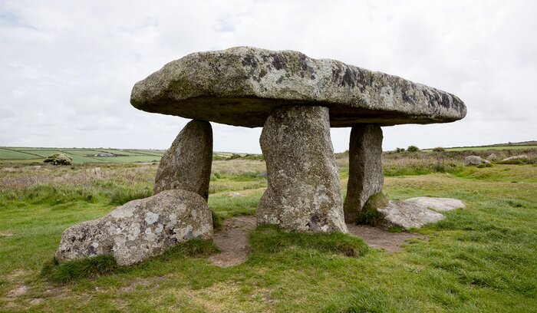

State of Capstone
Team: CFI
Chao Ding
Qichao Jiang
Xinyi Li
Zimo Wang

Slide 2
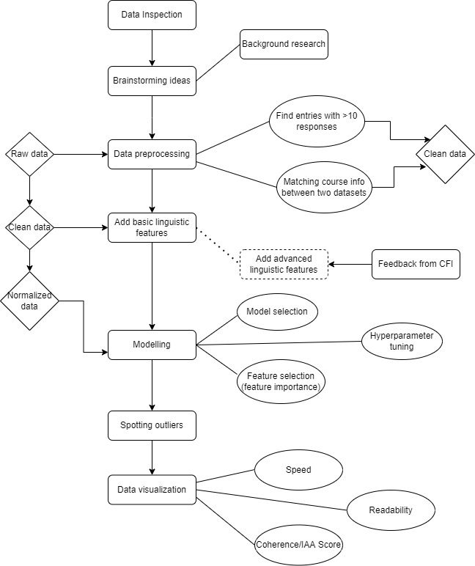
Workflow

Slide 3
Introduction
Project - Work on a end of course survey dataset and a course transcript dataset
End of Course Survey: 619,119 x 21 in shape, each data point is an entry to the survey.
{'CourseName': {0: 'Building a 3 Statement Financial Model'},
'CustomerID': {0: 198151},
'DateCompleted': {0: '2021-07-07 12:28:00.0000000'},
'FactId': {0: 142055},
'Instructor': {0: 'Tim Vipond'},
'Level': {0: 3},
'Price': {0: 197.0},
'Program': {0: 'FMVA'},
'Question_1': {0: 'How likely is it that you would recommend this course to a friend or colleague?'},
'Question_2': {0: 'This course covered the topics and content that you were expecting.'},
'Question_3': {0: 'The course materials were engaging, clear, and informative.'},
'Question_4': {0: 'The instructor was effective in delivering the course content.'},
'Question_5': {0: 'Do you have any other feedback to help us improve our course?'},
'Requirement': {0: 'Core'},
'Response_Q1': {0: 9},
'Response_Q2': {0: 'Agree'},
'Response_Q3': {0: 'Agree'},
'Response_Q4': {0: 'Agree'},
'Response_Q5': {0: 'Did Not Respond'},
'SurveyType': {0: 'NewSurvey'},
'VideoLenght': {0: '2-3 hrs'}}

Slide 4
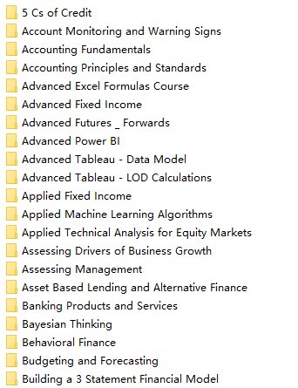
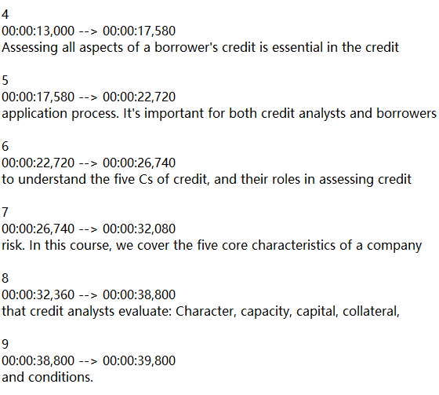
Introduction (continued)
Course Transcript: Raw transcript subtitles by chapter for 122/132 courses(excluded due to lack of response)
# of chapters
Each chapter
…
Goal: To improve course quality in many aspects, including review, transcript and more
…

Slide 5
Linguistic features
Basic/Statistics:'Chapter_count', 'word_count', 'sent_count', 'avg_sentence_length', 'avg_syllables_per_word', 'difficult_words','Duration','word_per_second'
Sentiment Analysis: 'verb_count', 'nnp_count', 'nn_count', 'adverb_count', 'ner_count', ‘Polarity’, 'avg_coherence'
Readability: 'flesch_reading_ease', 'gunning_fog', 'smog_index', 'dale_chall_readability_score'
Extra: ‘Inter-Annotator Agreement for Q2, Q3’
'Question_2': {0: 'This course covered the topics and content that you were expecting.'},
'Question_3': {0: 'The course materials were engaging, clear, and informative.'},

Slide 6
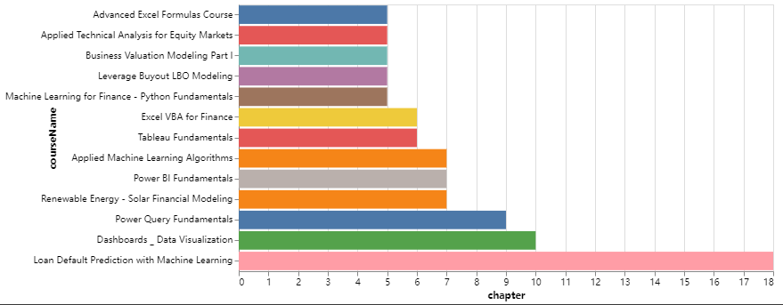
Visualization of average coherence distribution
Lowest 200 chapters - distribution

Slide 7
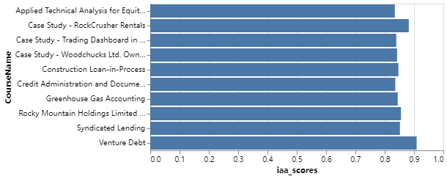
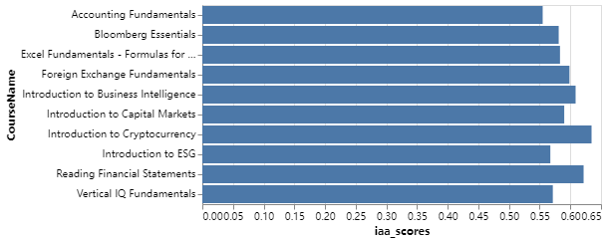
Inter-Annotator Agreement (Q2 & Q3)
—-Pair-wise Cohen kappa
Cohen’s 𝜅: two annotators annotating each instance with a category
Top 10 (excluding 1.0 or NaN)
Bottom 10

Slide 8
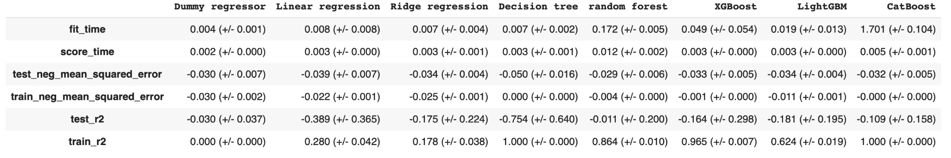
Model implementation
Course level data
Input: Linguistic features
Output prediction: Response_Q1
Model overfitting due to small data size (122 data points)
Negative test r2: model fits badly

Slide 9
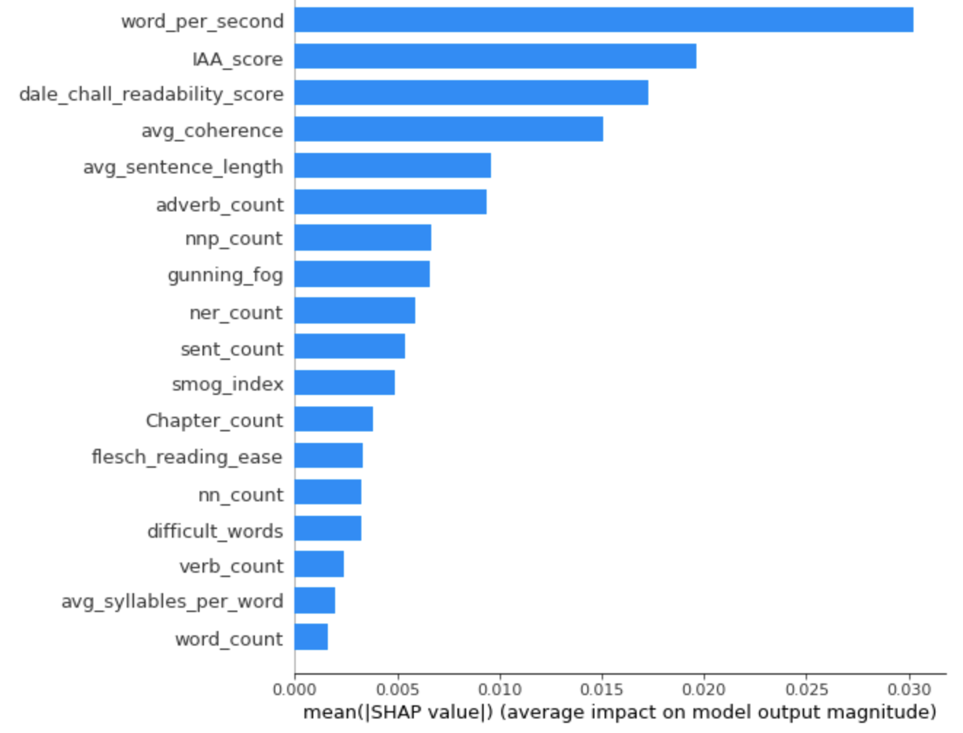
Model with Course level data
Feature importance

Slide 10
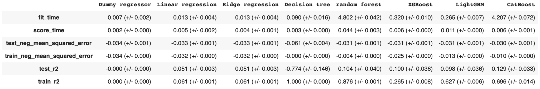
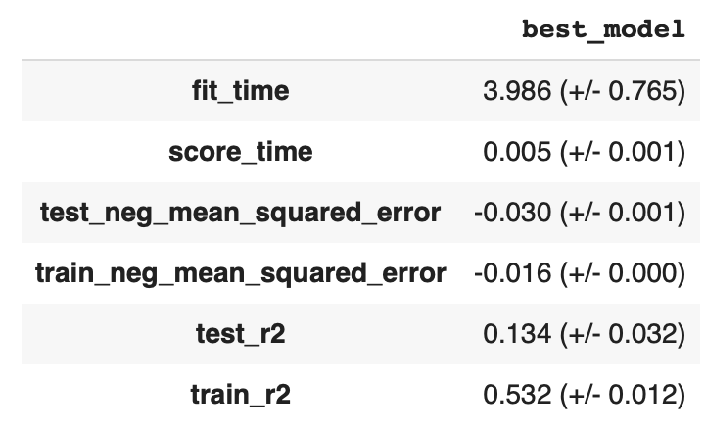
Model implementation
Chapter level data
Still overfitting, but the model performance is significantly improved with 5824 data points
The CatBoost regressor model has the highest test r2 and negative mean squared error
The Score is improved and the overfitting is reduced after the hyperparameter tuning

Slide 11
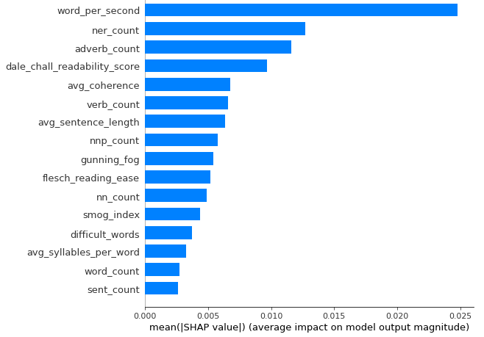
Model with Chapter level data
Feature importance

Slide 12
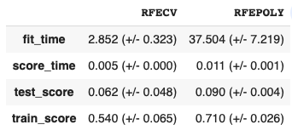
Feature selection attempt using recursive feature elimination (RFE)
MODELS
RFECV: Using RFE() and RidgeCV()
RFEPOLY: Using RFE() and RidgeCV() with Polynomial features
RESULTS
The feature selection attempt does not further improve the model performance, therefore all of the features are kept.

Slide 13
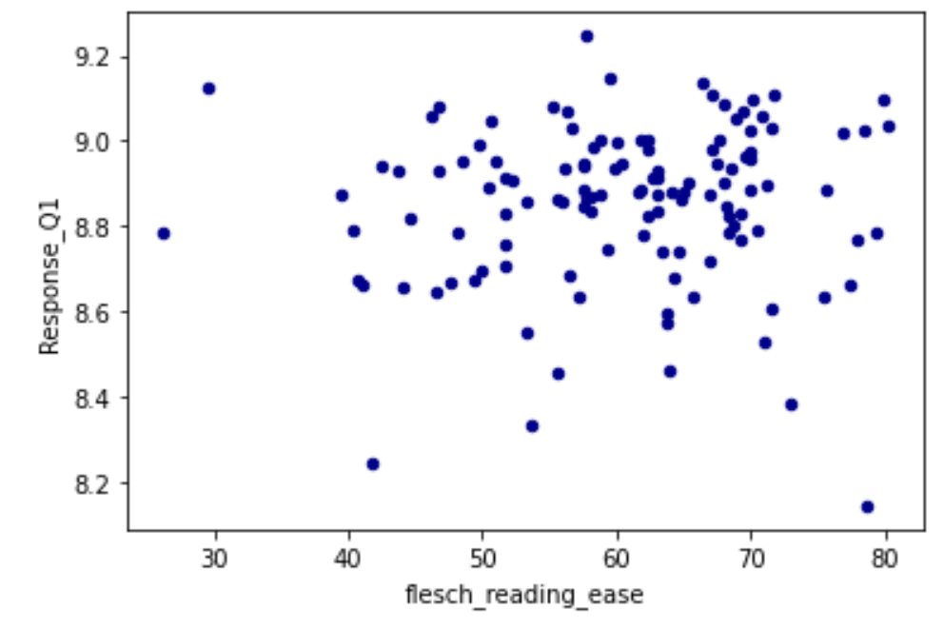
Feature outliers inspection
1.Flesch reading ease

Slide 14
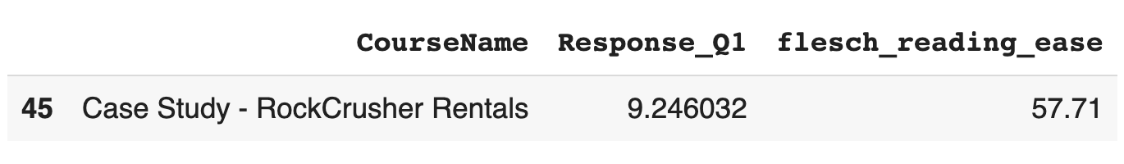
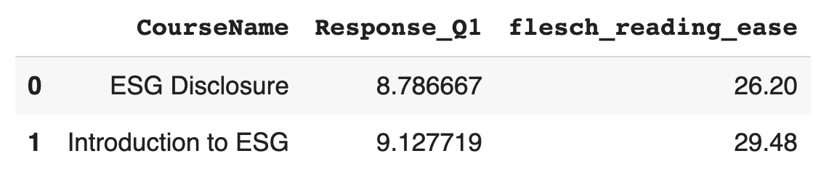
Feature outliers inspection
1.Flesch reading ease
This is the course with medium flesch reading ease but highest overall score:
These two courses shows a relative low flesch_reading_ease but the overall score is still decent. Interestingly, both of them are related to ESG.

Slide 15
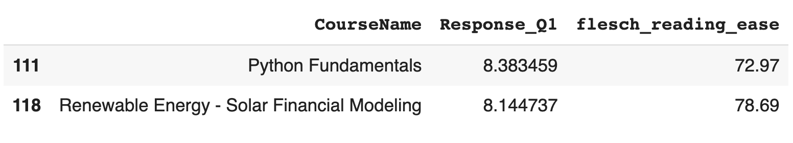
Feature outliers inspection
1.Flesch reading ease
This two courses have high flesch reading ease but the response is pretty bad.
In fact, Renewable Energy - Solar Financial Modeling has the highest flesch reading ease but the lowest score among all.

Slide 16
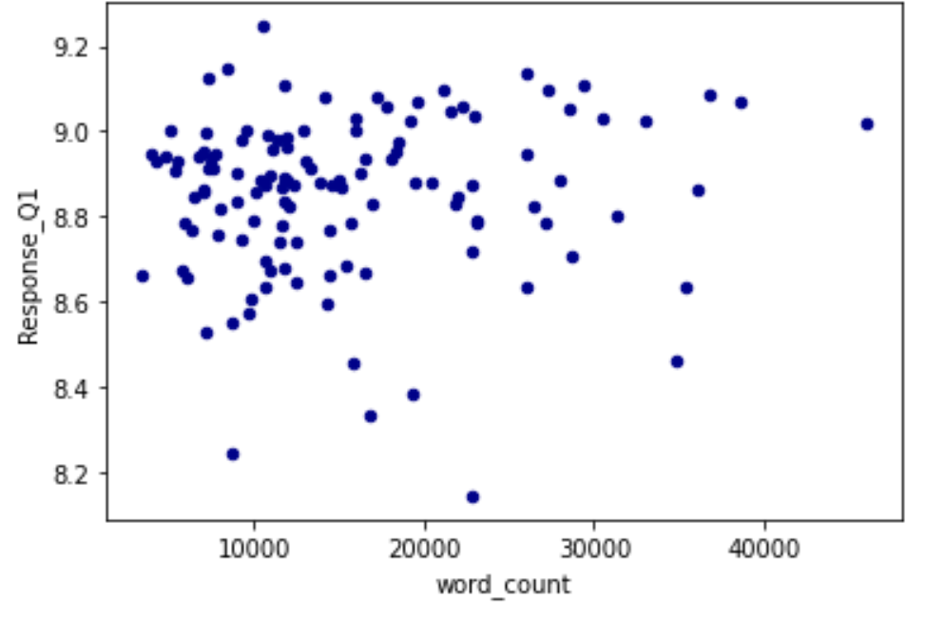
Feature outliers inspection
2.Word count

Slide 17
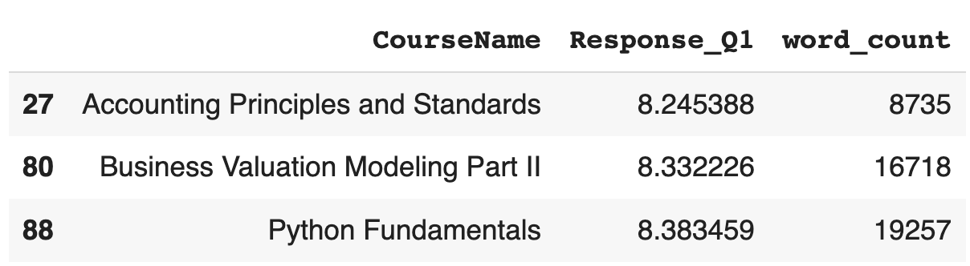
Feature outliers inspection
2.Word count
For these three courses, the word count is low, and the final score is low too.
These two courses shows a relative low flesch_reading_ease but the overall score is still decent. Interestingly, both of them are related to ESG.

Slide 18
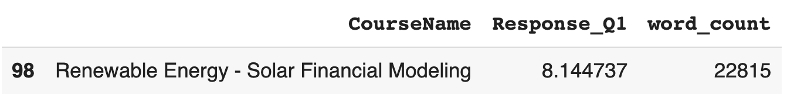
Feature outliers inspection
2.Word count
For the course Renewable Energy - Solar Financial Modeling, word count is not the highest but the score is the lowest
- (what could be the reason here? is it because the script is too hard to understand)

Slide 19
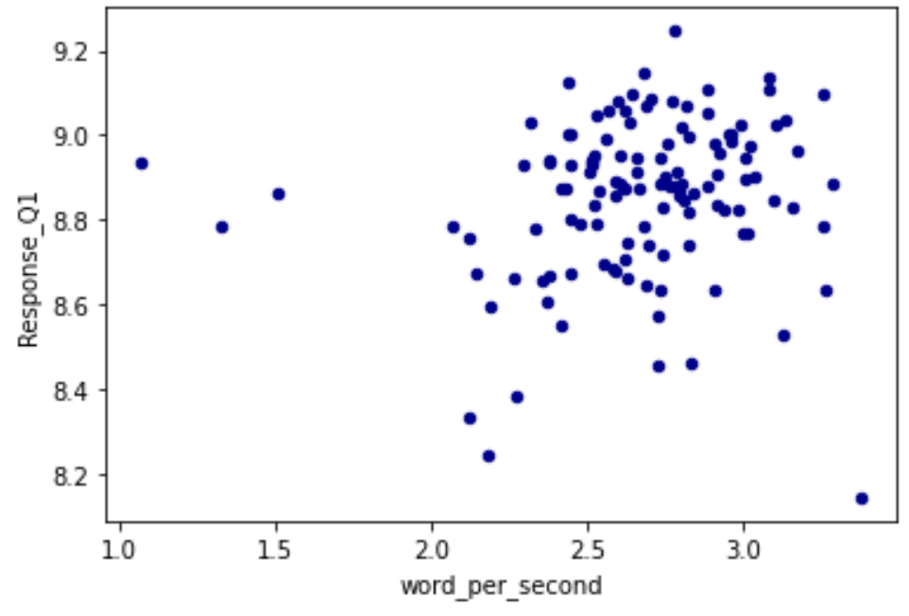
Feature outliers inspection
3.Speed (word per second)

Slide 20
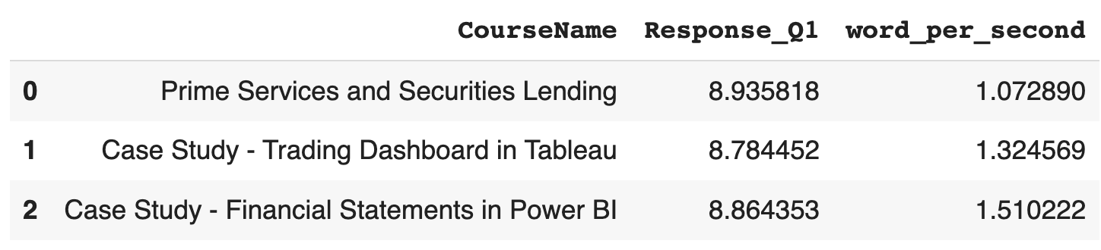
Feature outliers inspection
3.Speed (word per second)
These three courses are low in speed and receives pretty good scores.

Slide 21
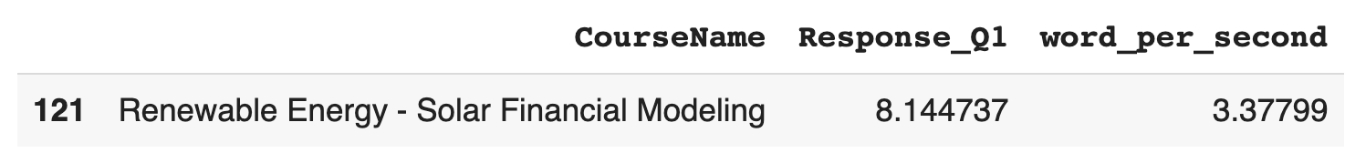
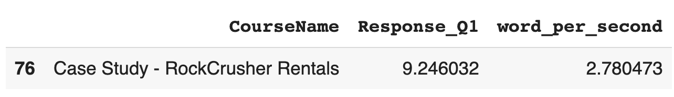
Feature outliers inspection
3.Speed (word per second)
This course has the highest speed among all and the lowest score.
This course has an above average speed while still keeping the highest score.

Slide 22
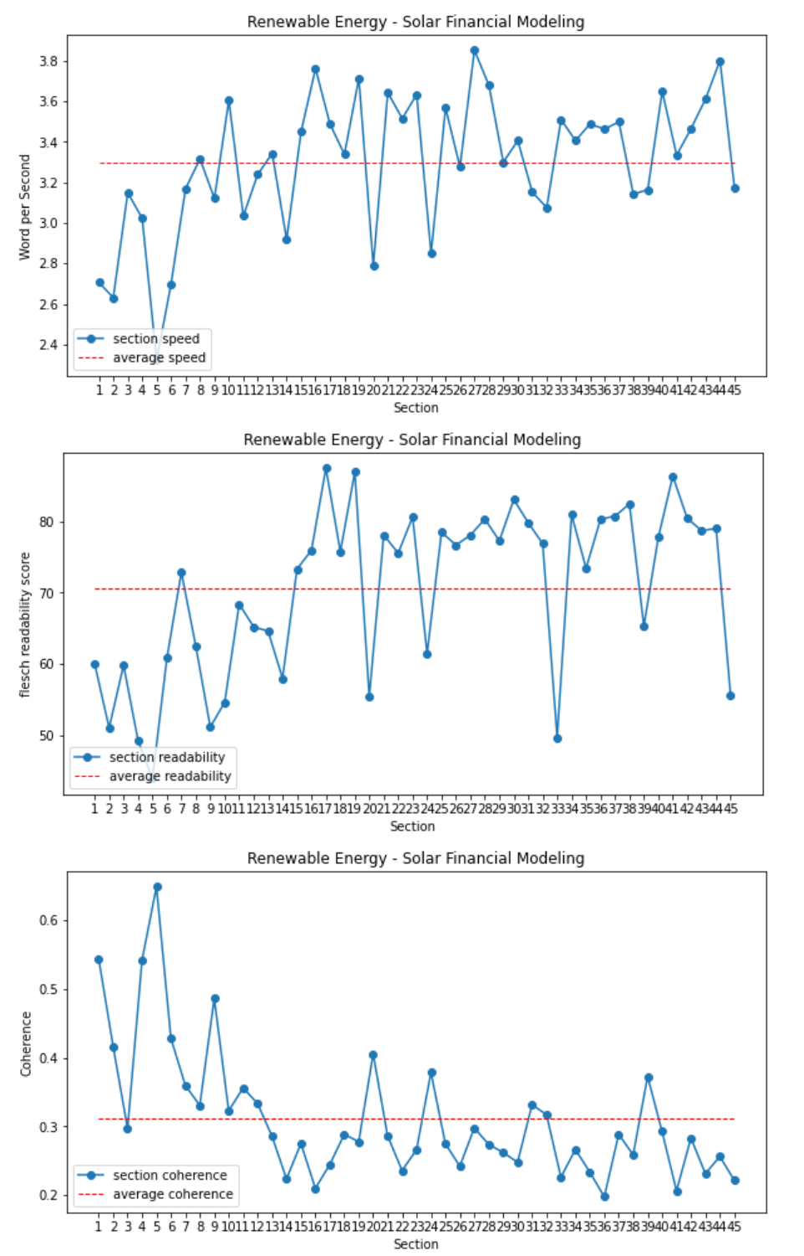
Visualization:
Renewable Energy - Solar Financial Modeling (8.14)
Notes:
We wrote functions to visualize the speed/flesch readability score and coherence of all sections of a course.
This is the vis of the course with lowest response score.
Hopefully this will help the decision makers and course designers to troubleshoot the section and reveal the reasons behind the low response score.

Slide 23
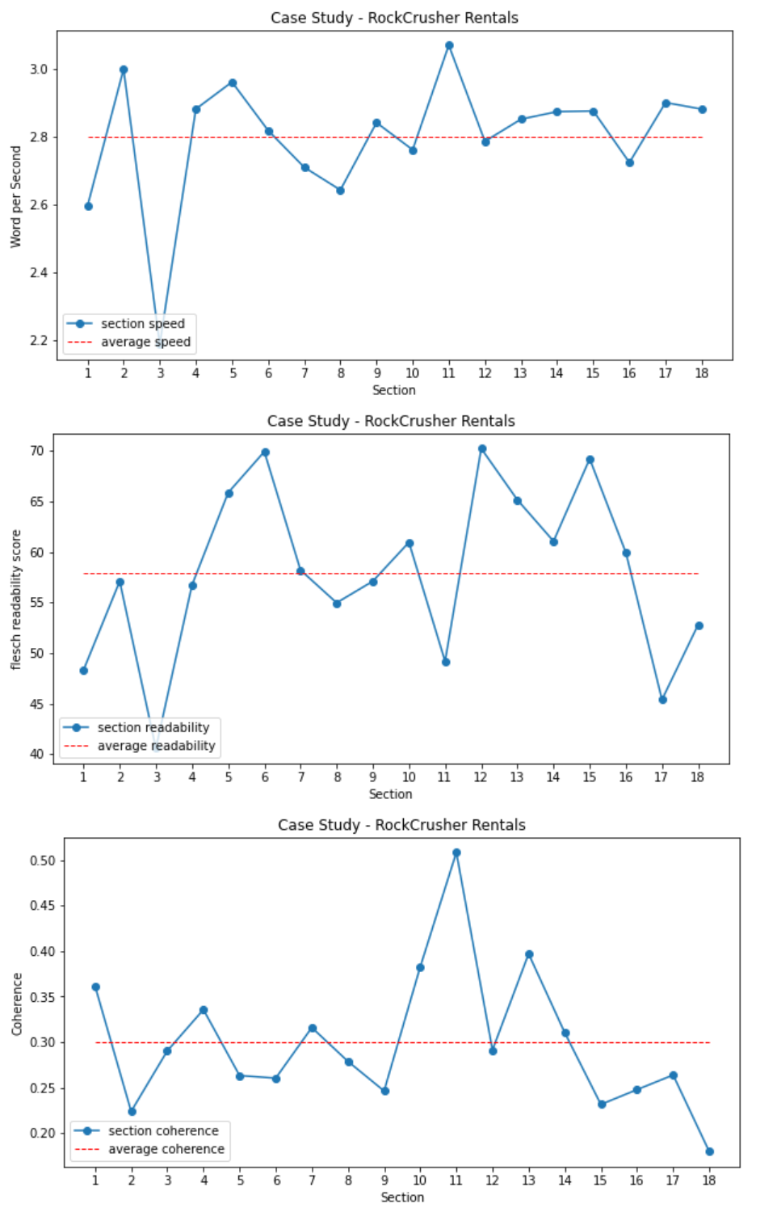
Visualization:
Case Study - RockCrusher Rentals (9.24)
Notes:
On the other side, this is the vis of the course with highest response score.
We can also find some interesting patterns of the course.
With more visualizations of some outlier data, we are gonna

Slide 24
Work distribution
All team members: Initial background research,
Xinyi Li:
Construct linguistics features to measure the quality of the course script.
Apply linear regression and SVR regression on the elementary features.
Qichao Jiang
Zimo Wang:
More linguistic features such as readability scores, POS tag counts, text coherence, Inter-Annotator Agreement score, and sentiment analysis features(to be done).
Add visualization to related features.
Chao Ding
Longformer
Linear regression model using transformer
Non-neural models such as linear regression, random forest etc. hyperparameter tuning and feature importance

Slide 25
Next week
Jiang: NPS score
(overlap: readability + speed + coherence + other important features)
Zimo: Polarity (comment)
Zimo: Humor detection (optional) (joke_count:)
Chao: Customer id (haters + fans)
Xinyi: Free v.s. Payed (response difference)

Slide 26
Before Friday
Todo:
Jiang: 132->129 () clean (response<10)
Jiang: transcript+duration+word_count
Zimo: run + coherence + IAA
Chao: Feature correlation + hyperparameter + model + feature importance
Xinyi: course selection
Jiang/Zimo: Visualization
Flow chart of entire project

